Slide 1
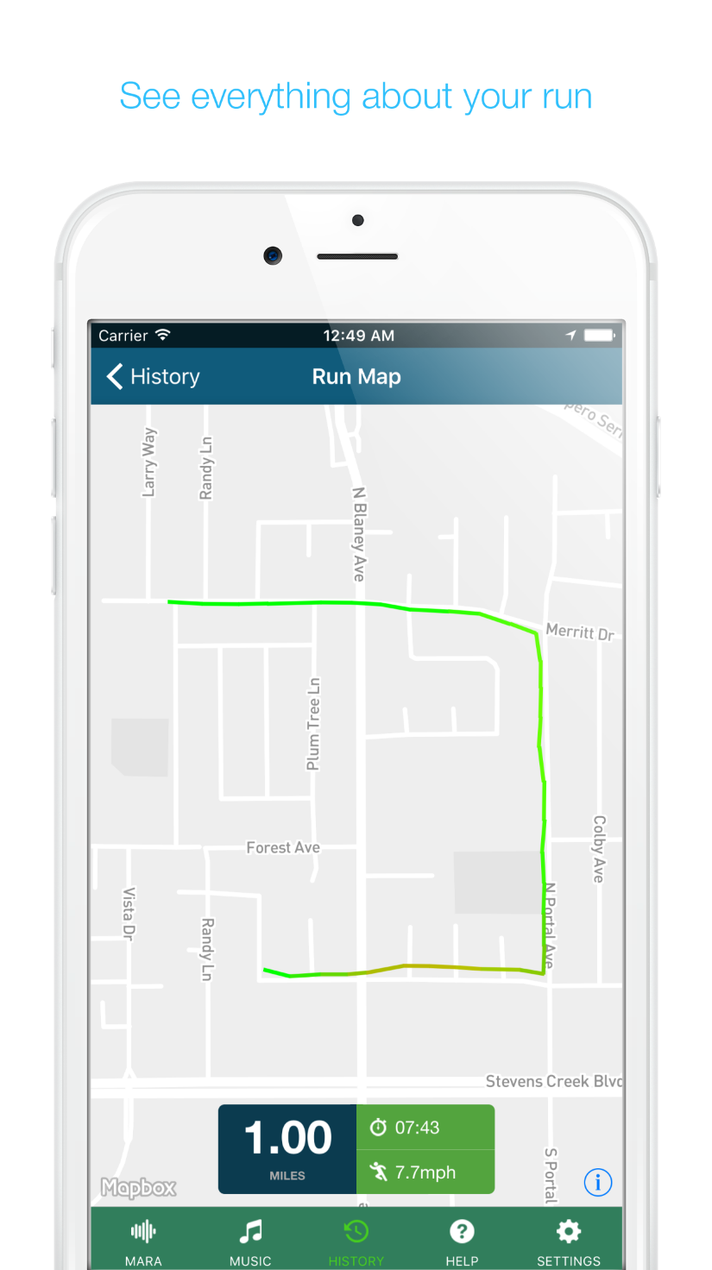
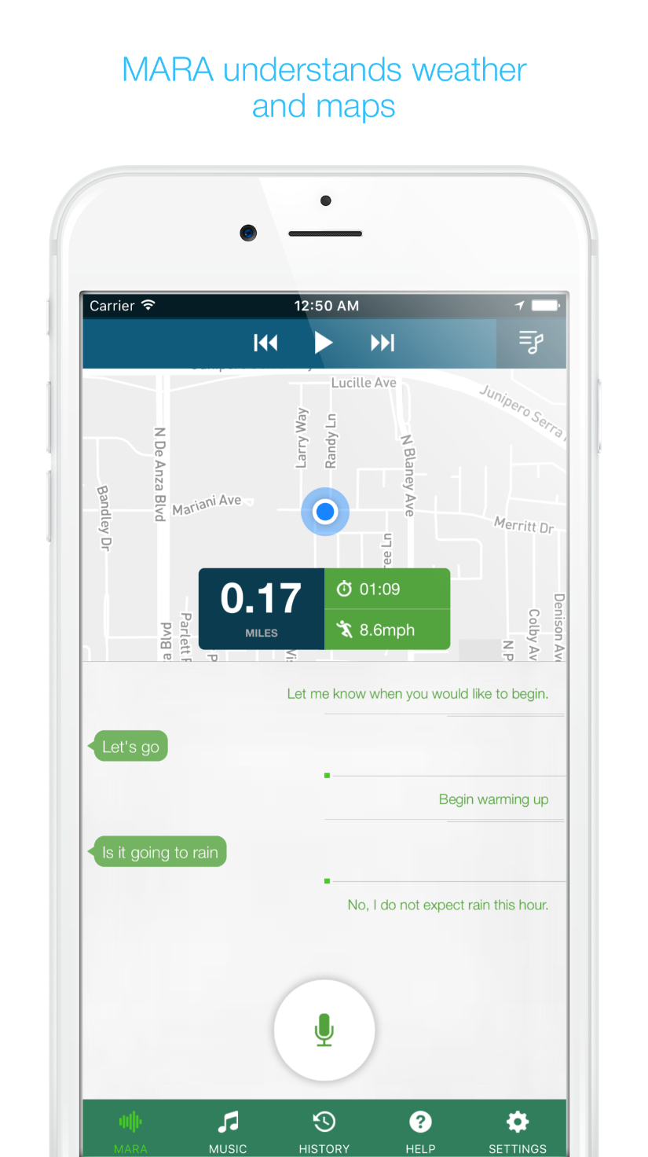
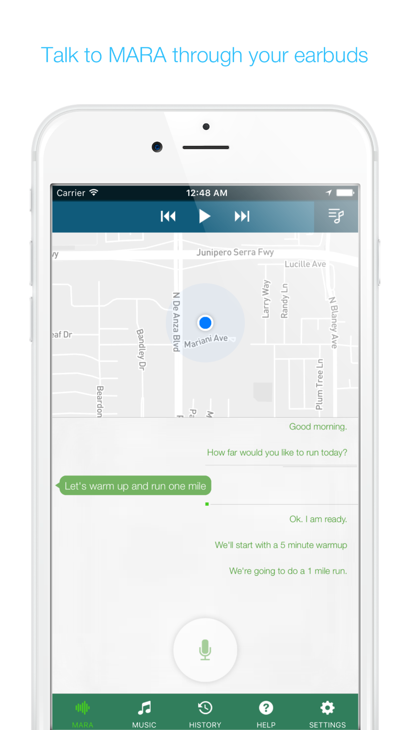
MARA – Mostly Audio Running Assistant
Business Need
MARA AI wanted to deliver a mobile experience that allowed runners to interact with their training data hands-free. The goal was to build a voice-enabled assistant that could guide athletes during their runs, provide real-time updates, and eliminate the need to manually check devices while on the move. A seamless, intuitive iOS app was required to make the assistant accessible in any running environment.
Outcomes
Designed and developed an iOS mobile app powered by a voice assistant tailored for runners
Enabled hands-free interaction for pace updates, distance tracking, and route guidance
Integrated MapBox for real-time route visualization and location tracking
Companion Amazon Alexa skill for querying running data

